Slide 1
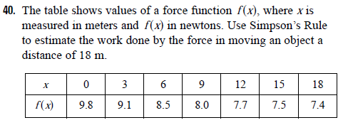
HW Problem
Notes:
When we take the limit of such Riemann sums, we get the situation illustrated.
A definite integral can be interpreted as a net area, that is, a difference of areas where A₁ is the area of the region above the x-axis and below the graph of f, and A₂ is the area of the region below the x-axis and above the graph of f.

Slide 2
Math 152 – Lesson 5
Lesson | Topic | Reading | Homework
M4 | Approximate Integration | 7.7 | 2,11
M5 | The Fundamental Theorem of Calculus | 5.3 | 2,21,37
M6 | Indefinite Integral and the Net Change Theorem | 5.4 | 49,51
Admin
25 Aug | Derivative Review (WeBWorK)
27 Aug | FSQ#1/FSPA #1 (WeBWorK)
27 Aug | HW Set #1 (L1 - L5)

Slide 3
The Fundamental Theorem of Calculus
The Fundamental Theorem of Calculus is appropriately named because it establishes a connection between the two branches of calculus: differential calculus and integral calculus.
It gives the precise inverse relationship between the derivative and the integral.

Slide 4


The Fundamental Theorem of Calculus
The first part of the Fundamental Theorem deals with functions defined by an equation of the form
where f is a continuous function on [a, b] and x varies between a and b. Observe that g depends only on x, which appears as the variable upper limit in the integral.
If x is a fixed number, then the integral is a definite number.
If we then let x vary, the number also varies and defines a function of x denoted by g(x).

Slide 5
The Fundamental Theorem of Calculus
If f happens to be a positive function, then g(x) can be interpreted as the area under the graph of f from a to x, where x can vary from a to b. (Think of g as the “area so far” function; see Figure 1.)
Figure 1

Slide 6
Example 1
If f is the function whose graph is shown in Figure 2 and find the values of g(0), g(1), g(2), g(3), g(4), and g(5). Then sketch a rough graph of g.
Figure 2

Slide 7

Example 1 – Solution
First we notice that .
From Figure 3 we see that g(1) is the
area of a triangle:
= (1  2) = 1
To find g(2) we add to g(1) the area of a rectangle:
= 1 + (1  2) = 3
= 1 + (1  2) = 3
= 1 + (1  2) = 3
Figure 3

Slide 8
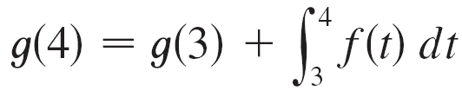
Example 1 – Solution
cont’d
We estimate that the area under f from 2 to 3 is about 1.3,
For t > 3, f (t) is negative and so we start subtracting areas:
≈ 3 + 1.3 = 4.3
Figure 3
≈ 4.3 + (–1.3) = 3.0
Figure 3

Slide 9
Example 1 – Solution
cont’d
We use these values to sketch the graph of g in Figure 4.
Notice that, because f (t) is positive for t < 3, we keep adding area for t < 3 and so g is increasing up to x = 3, where it attains a maximum value. For x > 3, g decreases because f (t) is negative.
≈ 3 + (–1.3) = 1.7
Figure 3
Figure 4

Slide 10
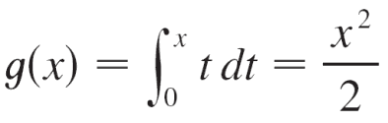
The Fundamental Theorem of Calculus
If we take, f (t) = t and a = 0, then we have Notice that g′(x) = x, that is, g′ = f. In other words, if g is defined as the integral of f by Equation 1, then g turns out to be an antiderivative of f, at least in this case.
And if we sketch the derivative of the function g shown in Figure 4 by estimating slopes of tangents, we get a graph like that of f in Figure 2. So we suspect that g′ = f in Example 1 too.
Figure 2

Slide 11
The Fundamental Theorem of Calculus
The fact that this is true, even when f is not necessarily positive, is the first part of the Fundamental Theorem of Calculus.
Using Leibniz notation for derivatives, we can write this theorem as
when f is continuous.

Slide 12
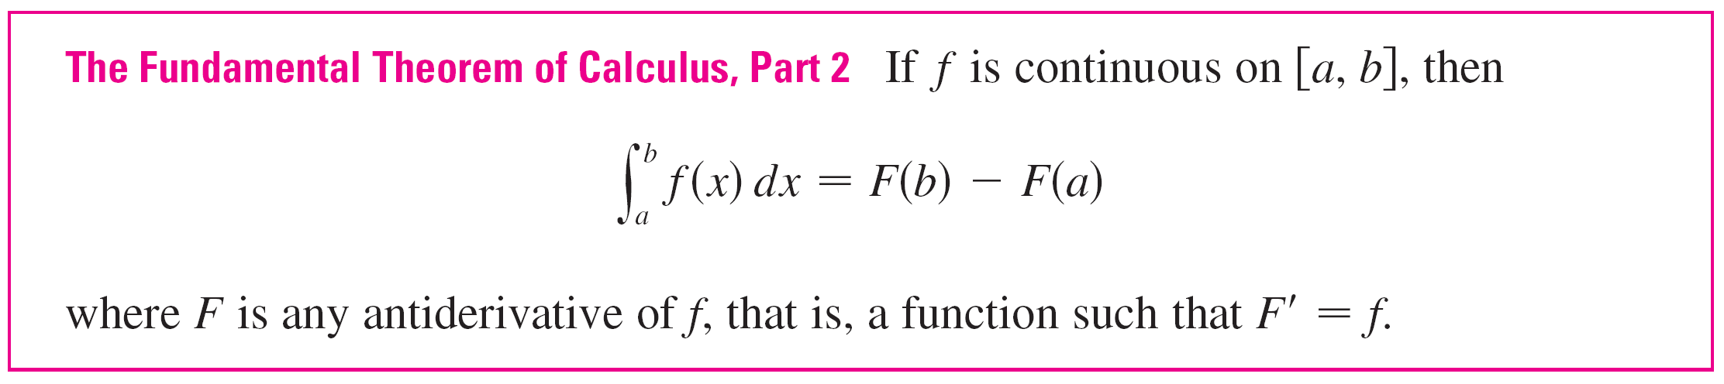
The Fundamental Theorem of Calculus
The second part of the Fundamental Theorem of Calculus, which follows easily from the first part, provides us with a much simpler method for the evaluation of integrals.

Slide 13
Differentiation and Integration as Inverse Processes
We end this section by bringing together the two parts of the Fundamental Theorem.
We noted that Part 1 can be rewritten as
which says that if f is integrated and then the result is differentiated, we arrive back at the original function f.

Slide 14
Differentiation and Integration as Inverse Processes

